Slide 1

Kaggle LANL Earthquake Prediction
Machine Learning and Exploratory Data Analysis
MSDS696 Data Science Practicum II – Regis University – Denver, CO
Kevin Maher
4/28/2019

Slide 2
About Me
Chose the project because it was a good fit for my math skills
Have taken courses in signal processing and have experience as a test engineer – which has proved useful here
Computer Science Graduate, working on a Masters Degree in Data Science at Regis University in Denver, CO
This is my final Masters project to complete the degree
No Geology background – this has been approached purely as a domain agnostic machine learning regression challenge
By day I am a Data Analyst and Data Engineer
Designing and maintaining database and data analysis systems for a manufacturer of electrified trucks

Slide 3
Introduction
Los Alamos National Laboratory has sponsored a machine learning challenge on Kaggle for entrants to predict the time when a laboratory earthquake will occur (Rouet-Leduc, et. al, 2019)
Will be approached as a regression problem because the time-to-failure – the next earthquake – is given as a continuous variable
Given an acoustic signal – extract useful statistics and predict the next quake with the regression model
The training signal is very long and has a number of earthquakes
The test signals are very small compared to the test signal – so the user must decide how to separate the training signal into slices that match the test signals

Slide 4
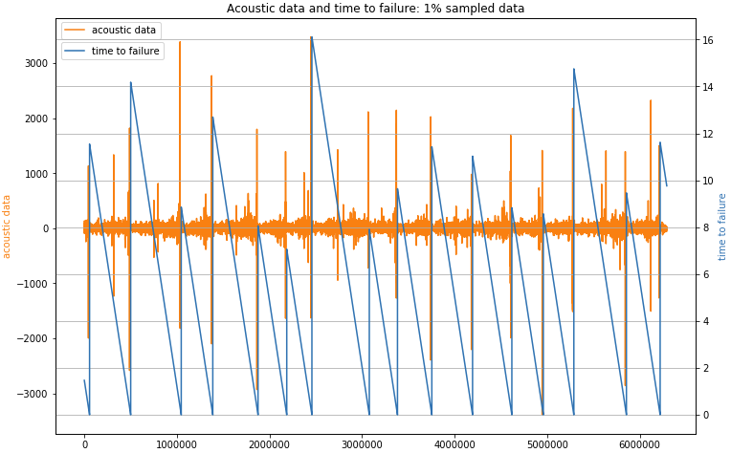
Training Data
Its huge! 629 million data points and 10GB storage on a hard drive
Only 16 earthquakes though so this will be a tough challenge
Earthquakes occur when the blue line jumps from near zero to a much higher value – 6 to 16 seconds apart
Signal Spikes seem to occur just before each quake – but we will find these difficult to exploit as we perform more exploratory analysis
Chart: Preda (2019)

Slide 5
Test Data
Provided by Kaggle in 150,000 sample chunks
No particular order and they are not from the same time as the training data – they are from another section of the same experiment
No time to earthquake information in the test chunks – like all Kaggle competitions we need to submit our model predictions to Kaggle who then scores them
This competition is scored by “Mean Absolute Error” - a common regression metric and the mean value of the absolute value of the errors – so a lower score is better and zero would be perfect!
We will need to look at the training data in 150,000 sample chunks because that is what is needed to match the test data
“Test” here means the data we test our models with, “Training” is the data we teach our model with

Slide 6
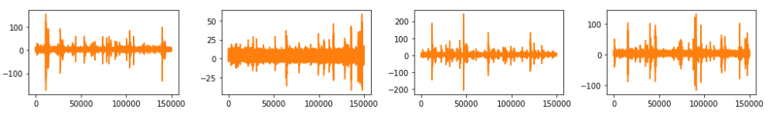
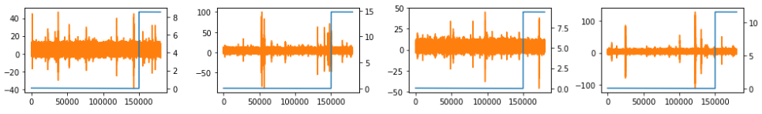
Test Data vs Training Data
2624 Test & 4194 Training Samples if dividing training data evenly
A few samples from each set – test on top, training on bottom
Hard to tell how similar they are from such a small sample – but we can quickly see the noise that we need to get 'data' from

Slide 7
Kaggle Kernel Scripts
There are a lot of great starter scripts available on Kaggle that the community has published
Will use two as a start for my own efforts
Feature Generation by Andrew Lukayenko (2019)
Modeling by Gabriel Preda (2019)
Important take aways:
Training signal is sliced into 4194 equal 150k slices to obtain training data whose size matches the test data samples
~150 Features are created from the signal through statistics and Fourier transform – that's a lot of ideas for features!
Preda uses a LightGBM model among others – this is one of the newer decision tree based gradient boosting machines

Slide 8
A Different Direction
The slice models where 4194 samples are taken from the training data in a non-overlapping manner have been well-explored on Kaggle
These result in models whose cross validation score is worse than their eventual leader board score
Using the Preda (2019) script and his LightGBM model a leader board score of 1.556 was observed, an ensemble would do better and Preda currently has a score around 1.45
Fourier transform features from the Lukayenko (2019) script take statistics on real and imaginary output of Fourier transform
Plan is to try approach with more data – 24k rows
These of necessity will overlap – risks leakage but also gets more data and allows for more features without “large p small n”
Fourier transform will concentrate on traditional magnitude and phase

Slide 9
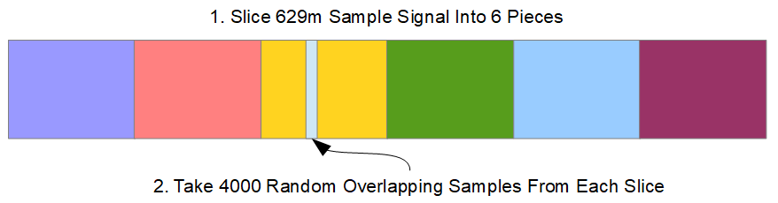
Slicing the Data
Plan is to get 24,000 rows of data from the training signal
Problem is training signal is HUGE – 629m rows
Solution – Multiprocessing (parallel processing)
So the feature generation script runs in a day rather than 4-6!
Slice 629m rows into 6 chunks so we don't need to load it 6 times
Take 4000 random slices on each chunk that are 150k long

Slide 10
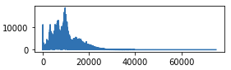
Filtering the Data
Now that we have more data – we can have more features
Fourier transform magnitude indicates most of the signal is below the 20k frequency line
From plots like the one below it appears that most energy is in the lower frequency bands
One way to get more features is to take the existing feature generation (Lukayenko, 2019) and create more signals by using low pass and band pass filters
Band pass filtering increases number of features to 900
Use digital filters to take slices
This is like dividing by musical note

Slide 11
Modeling the Data
LightGBM and XGBoost were easiest to work with on this data set
Training time was OK, gave good scores with minimal tuning
Deep Learning did not perform as well as gradient boosting
First Inspiration was that cross validation could be done both randomly and in a stratified manner
Now LightGBM and XGBoost give 4 models – 2 models x 2 CV
Stratified into 6 chunks that don’t overlap because of the original split for 6 process feature creation
Second inspiration was that Pearson’s coefficient test could be used for feature elimination – led to a decrease in error
Improved model feature selection was simply done by using p-value at a 0.05 threshold: 900 features reduced to 630

Slide 12
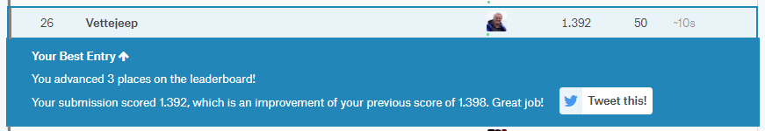
Result
Achieved Kaggle score of 1.392 on the public leader board
Top 1% at the time of submission to Kaggle!
Final model is an average of results from three models
Two of my best models, and, in the Kaggle tradition of using other people's work to improve one's own results, a script from Scirpus (2019) was added to the ensemble for scoring
Ensemble is done by averaging Kaggle submission results

Slide 13
REFERENCES
Chen, T., & Guestrin C. (2016). XGBoost: A scalable tree boosting system. In Proceedings of the 22nd ACM SIGKDD International Conference on Knowledge Discovery and Data Mining, KDD ’16, 785–794, New York, NY, USA.
Ke, G., Meng, Q., Findlay, T., Wang, T., Chen, W., Ma, W., … Liu, T. (2017, December). LightGBM: A Highly Efficient Gradient Boosting Decision Tree. In Guyon, I. & von Luxburg, U. (General Chairs), Thirty-first Conference on Neural Information Processing Systems (NIPS 2017). Long Beach, CA. Retrieved from: http://papers.nips.cc/paper/6907-lightgbm-a-highly-efficient-gradient-boosting-decision-tree
Lukayenko, A. (2019). Earthquakes FE. More features and samples. Kaggle. Retrieved from: https://www.kaggle.com/artgor/earthquakes-fe-more-features-and-samples
Preda, G (2019). LANL Earthquake EDA and Prediction. Kaggle. Retrieved from: https://www.kaggle.com/gpreda/lanl-earthquake-eda-and-prediction
Rouet-Leduc., et al (2019). LANL Earthquake Prediction. Kaggle. Retrieved from: https://www.kaggle.com/c/LANL-Earthquake-Prediction
Scirpus (2019). Andrews Script plus a Genetic Program Model. Kaggle. Retrieved from: https://www.kaggle.com/scirpus/andrews-script-plus-a-genetic-program-model/

